Slide 1

MP 651 Journal Club
Functional Connectivity in the Motor Cortex of Resting Human Brain Using Echo-Planar MRI
Bharat Biswal, F. Zerrin Yetkin, Victor M. Haughton, James S. Hyde
MRM 34:537~541, 1995

Slide 2


Background $∙$ Methods $∙$ Results $∙$ Conclusion
Physiological fluctuations in resting brain discovered by EPI MRI
A time course of signal intensities from a given pixel
Fourier transform used to show frequency components
[1] Heart rate [2] Respiratory sidebands with their harmonics
Low-frequency (<0.1 Hz) fluctuations observed. Focus of this paper!
High correlation between sensory motor cortex (hand movement) and low-frequency fluctuations within and across hemispheres
Correlation of electrical activity in the rat cerebral cortex with rCBF been reported
Frequency fluctuations are about the same as the fluctuations in human brain
Task-induced neuronal activity correlated with changes in [1] rCBF [2] blood oxygenation
Blood oxygenation sensitivity optimized in this study, although flow sensitivity remains
Fluctuations observed in the rat and in humans are of a similar nature

Slide 3

Background $∙$ Methods $∙$ Results $∙$ Conclusion
Study participant:
11 healthy human volunteers
  Right-handed (self-identified)
  8 M / 3 F (Age [24, 37])
  No history of head trauma / neurological disease
  No current use of medication and contradiction to MRI
Scan setting:
A standard GE 1.5T Signa clinical scanner
A home-built three-axis balanced-toque head gradient coil
A shielded end-capped quadrature transmit / receive birdcage radio frequency coil
Foam padding used to limit head movement

Slide 4
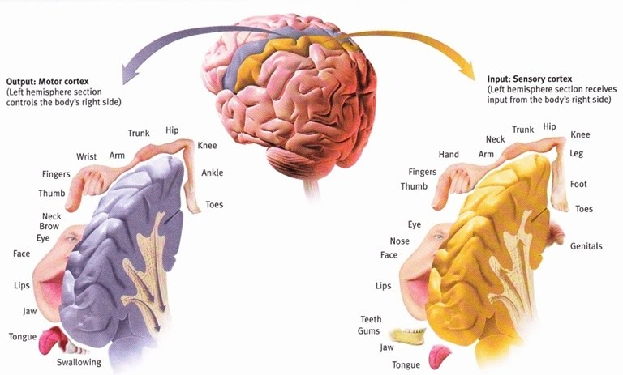
Background $∙$ Methods $∙$ Results $∙$ Conclusion
Scan protocol:
A single axial slice across motor cortex for each volunteer
High resolution GRASS sequence (TR = 600ms, TE = 10ms, FOV = 24cm, 256 x 256)
Several 512 EPI images obtained for functional imaging
  FOV = 24cm
  64 x 64
  TE = 40ms
Courtesy of: https://thealevelbiologist.co.uk/sensory-and-motor-areas-in-the-cortex/

Slide 5
Background $∙$ Methods $∙$ Results $∙$ Conclusion
Task design:
Rest state
Refrain any cognitive, language, or motor tasks
Task activation
Bilateral finger tapping
Tap each finger to the thumb sequentially
Without moving arms
Other controls: visual experiment
Rest
Task
20s
20s
Data analysis:
Square wave ( ) function with 20s period for task activation
All time course signal intensity normalized between 0 and 1
P < 0.001 was used for statistical significance
~ 60 Pixels identified as belong to finger motor cortex by passing the threshold
A finite impulse-response low-pass filter applied with a cut-off frequency of 0.08Hz
60 correlation-coefficient images generated from each resting brain study
Pixels counted with passing correlation-coefficient of 0.35 (i.e., P < 0.001)

Slide 6
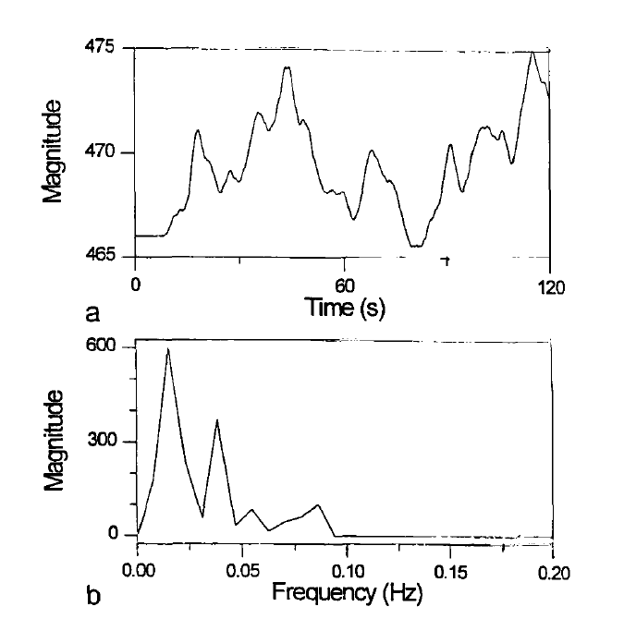

Background $∙$ Methods $∙$ Results $∙$ Conclusion
Time course of a pixel in motor cortex and its Fourier transform
FT
Fluctuations happened at low frequency
The significance of these frequency peaks has not yet been investigated

Slide 7
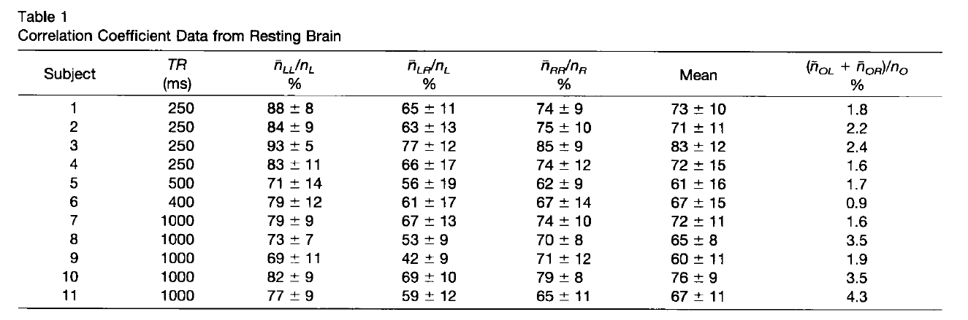


Background $∙$ Methods $∙$ Results $∙$ Conclusion
Pixel-counting results / Correlation coefficient
Control
$$>$$
$$<$$
L: left motor cortex R: right motor cortex O: rest of the brain
Connectivity within one region or between regions in the rest study

Slide 8
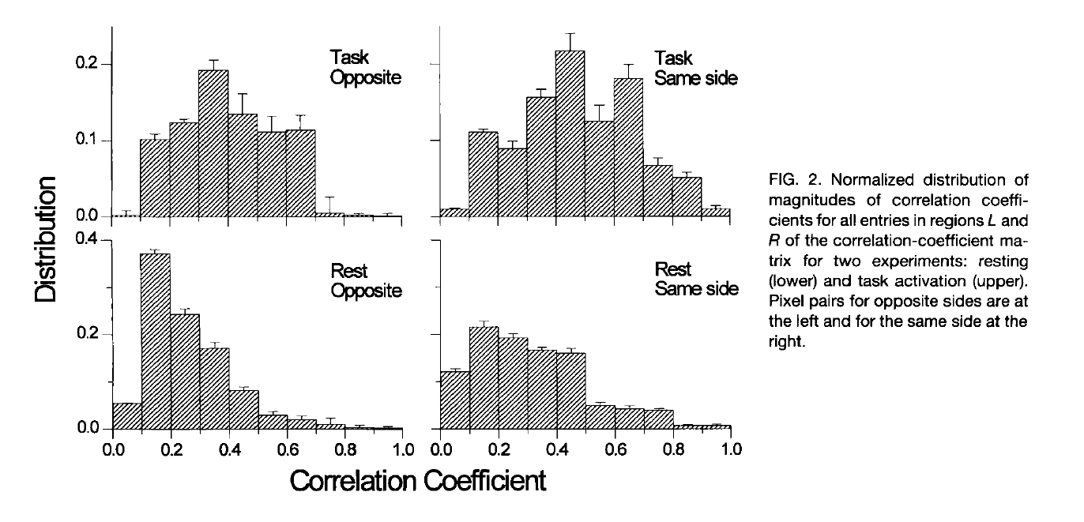
Background $∙$ Methods $∙$ Results $∙$ Conclusion
Histograms of the distribution of correlation coefficients magnitudes
n_{LR} and n_{RL}
n_{LL} and n_{RR}
More strongly correlated pixel pairs in the task-activated data

Slide 9
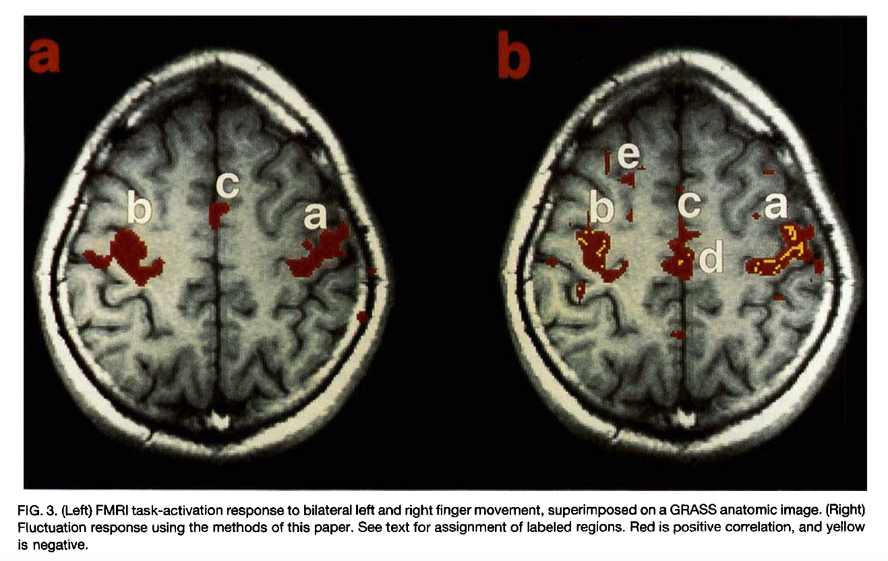
Background $∙$ Methods $∙$ Results $∙$ Conclusion
Correlations with voxels in motor cortex at rest

Slide 10

Background $∙$ Methods $∙$ Results $∙$ Conclusion
Similar fluctuations giving rise to functional connectivity observed in the auditory and visual cortex
General phenomena, not due to imagined motor tasks.
Imaged activation was random for each subject as well as between subjects.
Comparisons using different reference vectors needed for further investigation.
Limitations and Future Work
Whole-volume RF coil necessary for study correlation of fluctuations across entire brain.
Surface coil can be used to obtain high quality data.
Conclusion
Functionally related brain regions showed correlation of low frequency fluctuations in resting state detected by EPI data.
Low frequency fluctuation of blood flow and oxygenation is indeed a neurophysiological index.

